Slide 1

The National University of Computer and Emerging Sciences
Type Casting
CS 1002 Programming Fundamentals
Dr. Akhtar Jamil
Department of Computer Science

Slide 2
Goals
Type Casting

Slide 3
Today’s Lecture

Slide 4
Type Casting
Notes:
Output=311

Slide 5
Type Coercion
Coercion: automatic conversion of an operand to another data type
Promotion: converts to a higher type
float p; p = 7; ➔ 7 (int) converted to float 7.0
Demotion: converts to a lower type
int q; q = 3.5; ➔ 3.5 (float) converted to int 3

Slide 6
Coercion Rules
char, short, unsigned short are automatically promoted to int
When operating on values of different data types, the lower one is promoted to the type of the higher one.
For the assignment operator = the type of expression on right will be converted to the type of variable on left

Slide 7
Typecasting
A mechanism by which we can change the data type of a variable (no matter how it was originally defined)
Two ways:
Implicit type casting (done by compiler)
Explicit type casting (done by programmer)

Slide 8
Implicit type casting
As seen in previous examples:
void main( )
{
char c = 'a';
float f = 5.0;
float d = c + f;
cout<<d<<“ “<<sizeof(d)<<endl;
cout<<sizeof(c+f);
}

Slide 9
Numeric Type Conversion
Consider the following statements:
short i = 10;
long k = i * 3 + 4;
double d = i * 3.1 + k / 2;
cout<<d;

Slide 10
Type Conversion Rules
Auto Conversion of Types in C++
If one of the operands is long double, the other is converted into long double
Otherwise, if one of the operands is double, the other is converted into double.
Otherwise, if one of the operands is unsigned long, the other is converted into unsigned long.
Otherwise, if one of the operands is long, the other is converted long.
Otherwise, if one of the operands is unsigned int, the other is converted into unsigned int.
Otherwise, both operands are converted into int.

Slide 11
Overflow and Underflow
When a variable is assigned a value that is too large or too small in range:
Overflow
Underflow
After overflows/underflow values wrap around the maximum or minimum value of the type

Slide 12
Example
// testVar is initialized with the maximum value for a short.
short int testVar = 32767;
// Display testVar.
cout <<"\nOrignal value: "<<testVar <<endl;
// Add 1 to testVar to make it overflow.
testVar = testVar + 1;
cout <<"\nValue Overflow +1: "<<testVar << endl;
// Subtract 1 from testVar to make it underflow.
testVar = testVar - 1;
cout <<"\nValue underflow -1: "<<testVar << endl;

Slide 13
Explicit type casting
Explicit casting performed by programmer. It is performed by using cast operator
float a=5.0, b=2.1;
int c = a%b; // → ERROR
Three Styles
int c = (int) a % (int) b; //C-style cast
int c = int(a) % int(b); // Functional notation
int c = static_cast<int>(a) % static_cast<int>(b);
cout<<c;
Notes:
Use static_cast wherever you were using C-style cast.
Use dynamic_cast with polymorphic classes. Keep in mind that you should only use dynamic_cast in classes with at least one virtual member in the inheritance hierarchy.
Use const_cast when you need to remove const or volatile qualifiers.
Use reinterpret_cast when you have no options.

Slide 14
Explicit Type Casting
- Casting does not change the variable being cast.
For example, d is not changed after casting in the following code:
double d = 4.5;
int j = (int) d; //C-type casting
int i = static_cast<int>(d); // d is not changed
cout<<j<<“ “<<d;

Slide 15
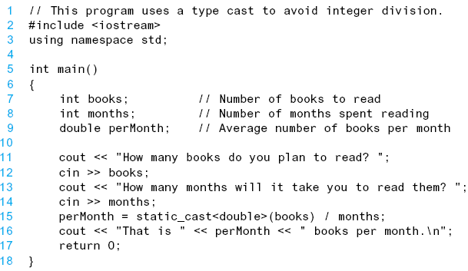
Explicit Type Casting - Example

Slide 16
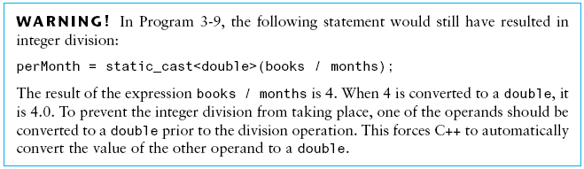
Explicit Type Casting - Example

Slide 17
Widening type casting
A "widening" cast is a cast from one type to another, where the "destination" type has a larger range or precision than the "source“
Example:
int i = 4;
double d = i;

Slide 18
Narrowing type casting
A “narrowing" cast is a cast from one type to another, where the "destination" type has a smaller range or precision than the "source“
Example:
double d = 787994.5;
int j = (int) d;
// or
int i = static_cast<int>(d);

Slide 19
Casting between char and Numeric Types
int i = 'a'; // Same as int i = (int) 'a';
char c = 97; // Same as char c = (char)97;

Slide 20
References
Credit goes to Dr. Muhammad Aleem for preparation of slides
Text book: Starting out with c++

Slide 21
Thank You ☺

